Slide 1
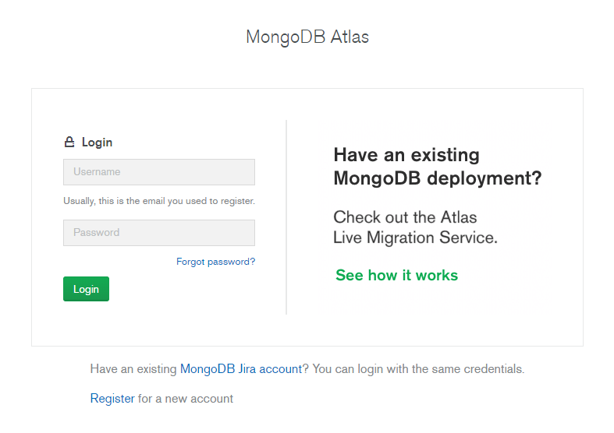
1. MongoDB Atlas 접속
https://cloud.mongodb.com/user#/atlas/login

Slide 2
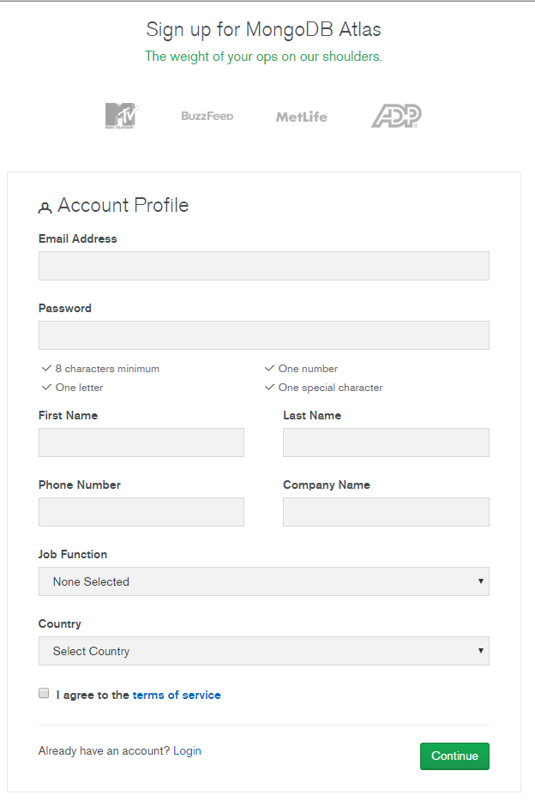
2. 회원가입

Slide 3
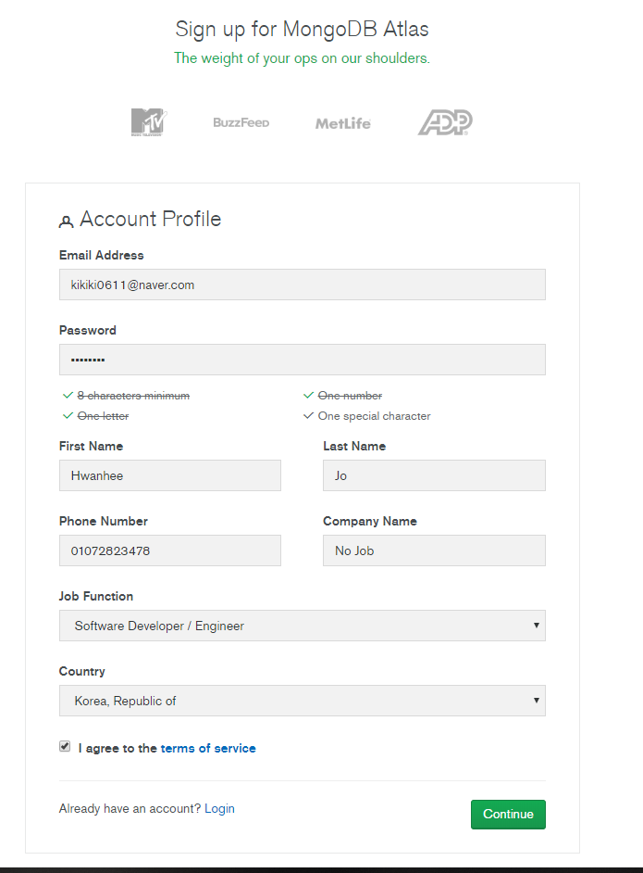
3. 회원가입

Slide 4
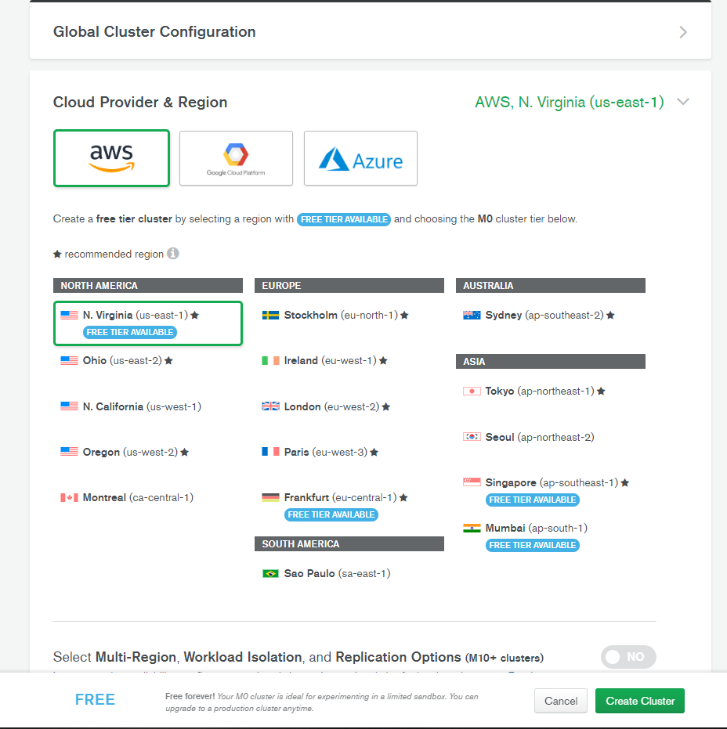
4. 무료 Cluster 생성

Slide 5
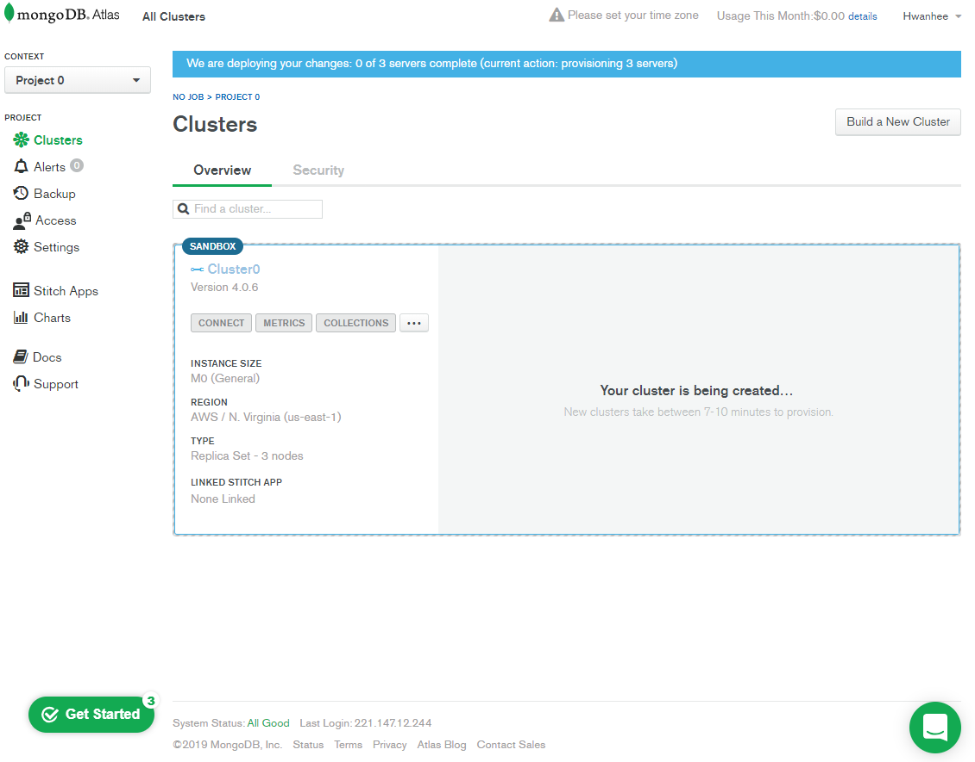
4. Security 클릭

Slide 6
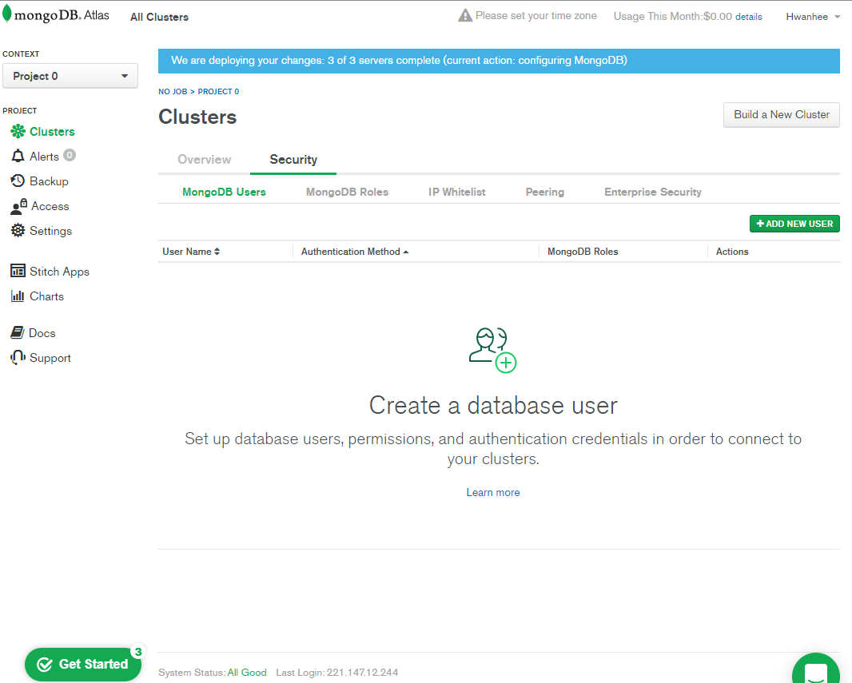
5. Add new user

Slide 7
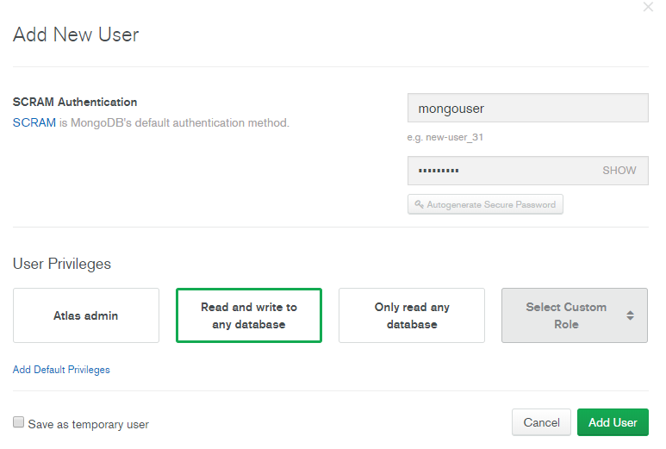
6. User ID, PW 입력 및 생성

Slide 8
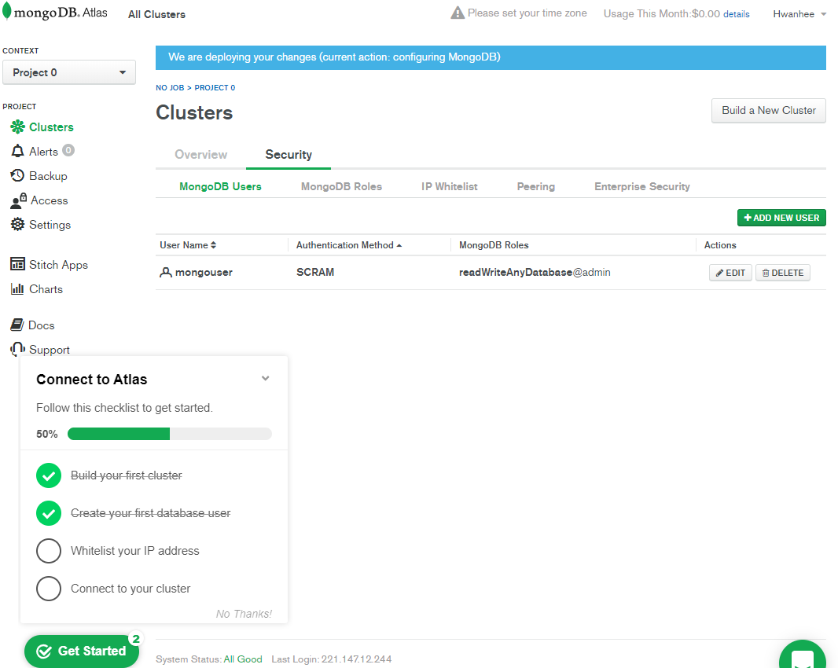
7. IP WhiteList

Slide 9
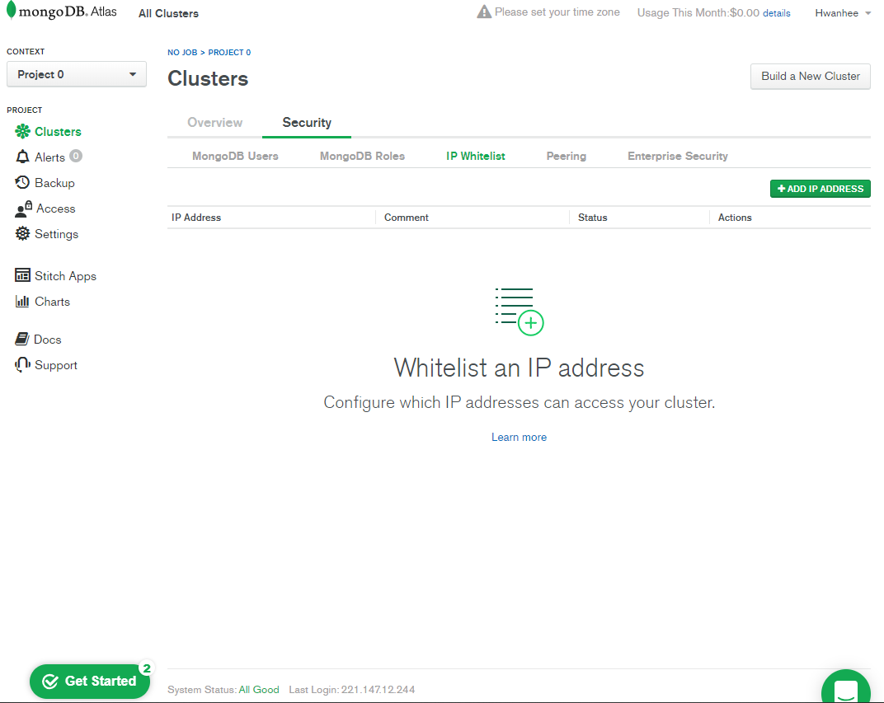

Slide 10
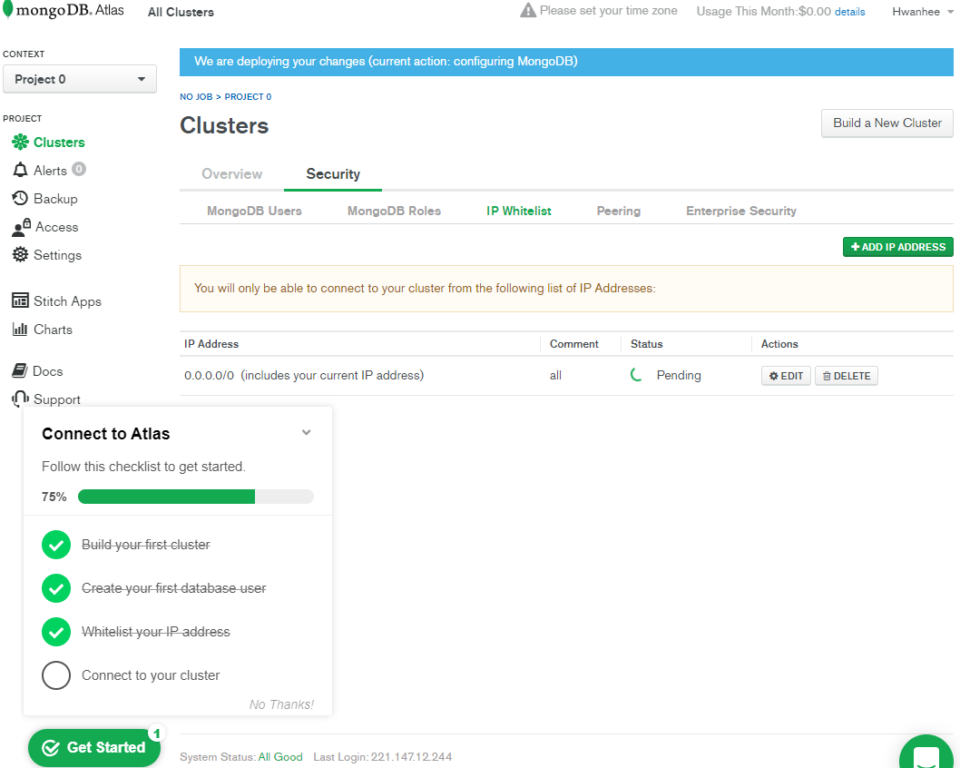

Slide 11
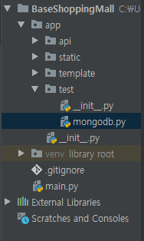
8. 지난 소스에서 아래와 같이 구성

Slide 12
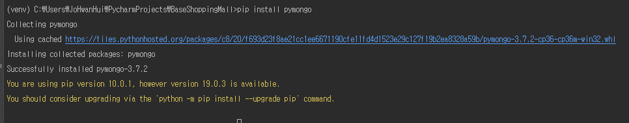
9. 몽고디비 파이썬 라이브러리 설치

Slide 13
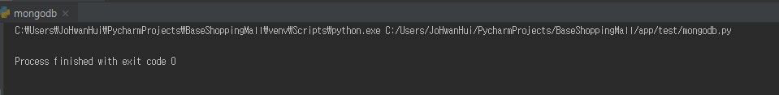
10. 테스트 코드 작성 및 동작 확인
from pymongo import MongoClient client = MongoClient("mongodb://mongouser:mongouser@" "cluster0-shard-00-00-llkya.mongodb.net:27017," "cluster0-shard-00-01-llkya.mongodb.net:27017," "cluster0-shard-00-02-llkya.mongodb.net:27017" "/test?ssl=true&replicaSet=Cluster0-shard-0&authSource=admin&retryWrites=true") test = client.test

Slide 14
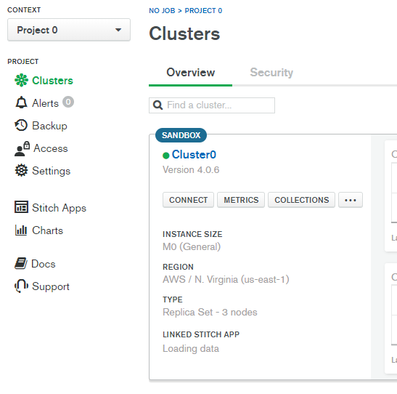
10. 다시 웹에서 아래 버튼 클릭

Slide 15
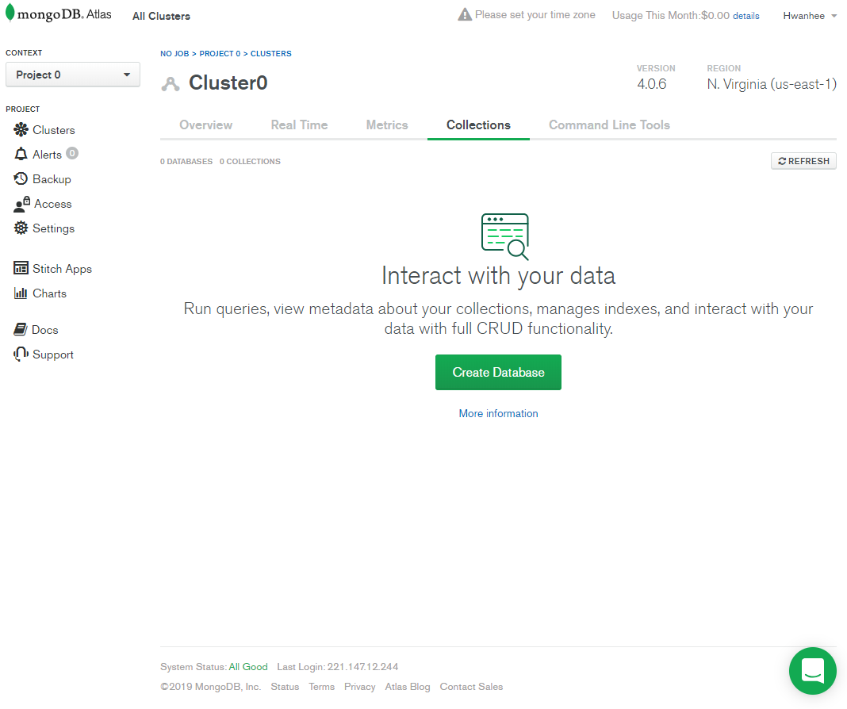
11. DB 생성

Slide 16
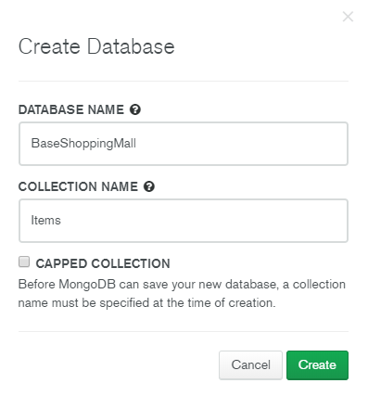
12. DB이름과 Collection 이름 설정

Slide 17
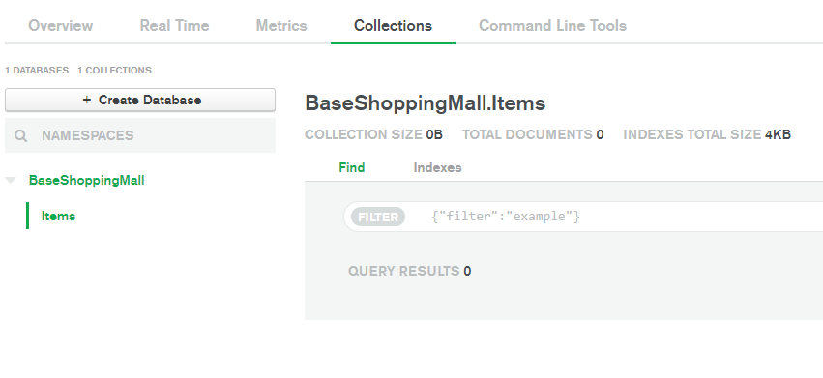
13. 생성된 디비와 컬렉션 확인

Slide 18
14. 다시 웹에서 아래 버튼 클릭

Slide 19
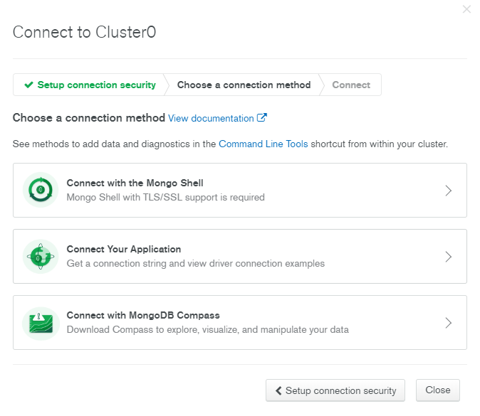
15. 아래 버튼 클릭

Slide 20
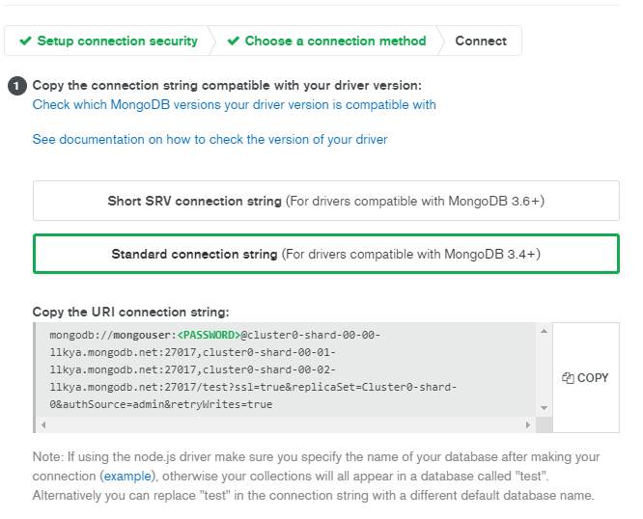
16. Standard connection string에서 copy 클릭

Slide 21
17. 아래와 같이 작성 해본 후 동작확인
from pymongo import MongoClient client = MongoClient("mongodb://mongouser:mongouser@" "cluster0-shard-00-00-llkya.mongodb.net:27017," "cluster0-shard-00-01-llkya.mongodb.net:27017," "cluster0-shard-00-02-llkya.mongodb.net:27017" "/BaseShoppingMall?ssl=true&replicaSet=Cluster0-shard-0&authSource=admin&retryWrites=true") baseShoppingMall = client["BaseShoppingMall"] items = baseShoppingMall["Items"] item = { "name": "가디건", "caption": "초특가!", "price": "10,000원", "url": "/static/img/sample.jpg", } items.insert_one(item)

Slide 22
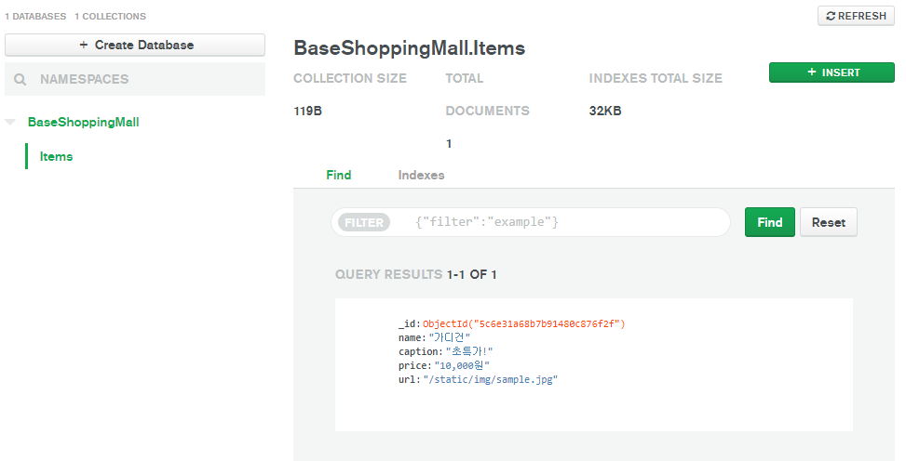
18. 데이터가 잘 삽입된 모습

Slide 23
19. 데이터 검색 테스트
from pymongo import MongoClient client = MongoClient("mongodb://mongouser:mongouser@" "cluster0-shard-00-00-llkya.mongodb.net:27017," "cluster0-shard-00-01-llkya.mongodb.net:27017," "cluster0-shard-00-02-llkya.mongodb.net:27017" "/BaseShoppingMall?ssl=true&replicaSet=Cluster0-shard-0&authSource=admin&retryWrites=true") baseShoppingMall = client["BaseShoppingMall"] items = baseShoppingMall["Items"] # item = { # "name": "가디건", # "caption": "초특가!", # "price": "10,000원", # "url": "/static/img/sample.jpg", # } # # items.insert_one(item) foundItem = items.find_one({"name":"가디건"}) print(foundItem)

Slide 24
20. 새로운 데이터 추가
from pymongo import MongoClient client = MongoClient("mongodb://mongouser:mongouser@" "cluster0-shard-00-00-llkya.mongodb.net:27017," "cluster0-shard-00-01-llkya.mongodb.net:27017," "cluster0-shard-00-02-llkya.mongodb.net:27017" "/BaseShoppingMall?ssl=true&replicaSet=Cluster0-shard-0&authSource=admin&retryWrites=true") baseShoppingMall = client["BaseShoppingMall"] items = baseShoppingMall["Items"] item = { "name": "청바지", "caption": "초특가!", "price": "15,000원", "url": "/static/img/sample.jpg", } items.insert_one(item)

Slide 25
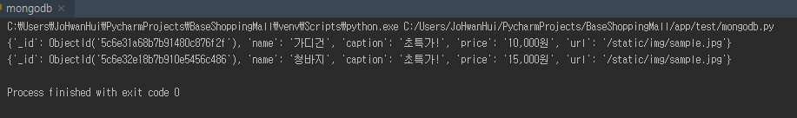
21. 데이터 검색 테스트-2
from pymongo import MongoClient client = MongoClient("mongodb://mongouser:mongouser@" "cluster0-shard-00-00-llkya.mongodb.net:27017," "cluster0-shard-00-01-llkya.mongodb.net:27017," "cluster0-shard-00-02-llkya.mongodb.net:27017" "/BaseShoppingMall?ssl=true&replicaSet=Cluster0-shard-0&authSource=admin&retryWrites=true") baseShoppingMall = client["BaseShoppingMall"] items = baseShoppingMall["Items"] foundItems = items.find({}) for item in foundItems: print(item)

Slide 26
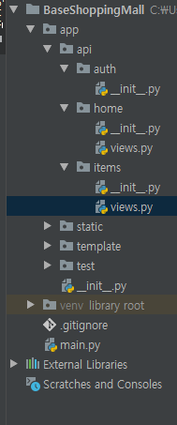
22. 지난 소스를 수정해보자
from flask import render_template from . import items from pymongo import MongoClient client = MongoClient("mongodb://mongouser:mongouser@" "cluster0-shard-00-00-llkya.mongodb.net:27017," "cluster0-shard-00-01-llkya.mongodb.net:27017," "cluster0-shard-00-02-llkya.mongodb.net:27017" "/BaseShoppingMall?ssl=true&replicaSet=Cluster0-shard-0&authSource=admin&retryWrites=true") @items.route('/') def homepage(): baseShoppingMall = client["BaseShoppingMall"] items = baseShoppingMall["Items"] my_items = items.find({}) return render_template('/items/index.html', title="Welcome", items=my_items)

Slide 27
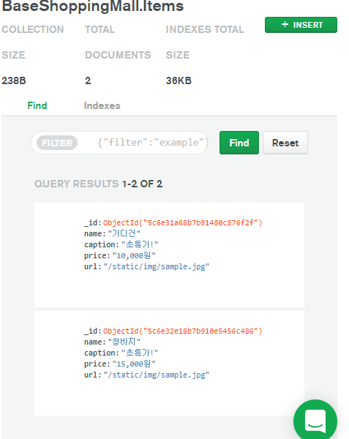
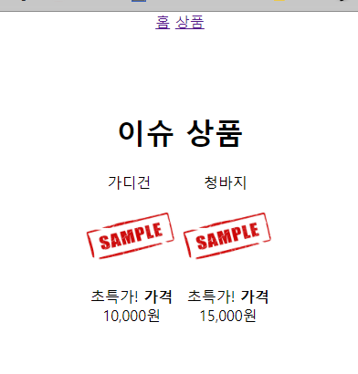
23. 실제 DB와 데이터가 일치하는 것을 확인

Slide 28
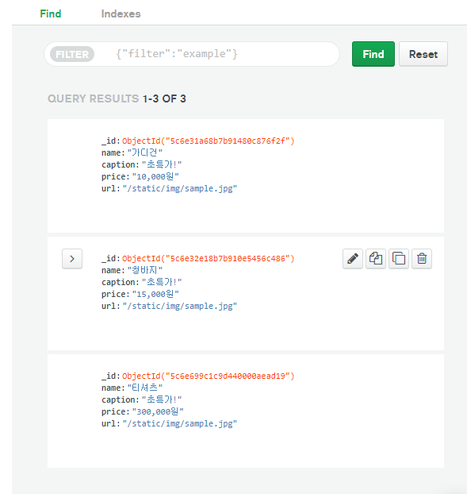
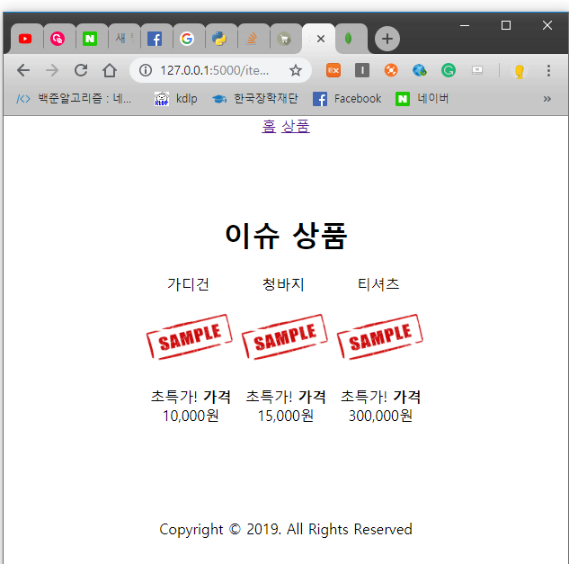
23. 실제 DB와 데이터가 일치하는 것을 확인
임의로 DB에 데이터를 추가!!
제대로 늘어난 모습

